Slide 1
small world
Six Degrees of Separation

Slide 2

This is the title of the play written by John Guare and premiered in 1990. This is also the title of the movie released in 1993.
I read somewhere that everybody on this planet is separated by only six other people. Six degrees of separation between us and everyone else on this planet. The President of the United States, a gondolier in Venice, just fill in the names.
Notes:
Any two people in the world are connected by a short chain of acquaintances.

Slide 3
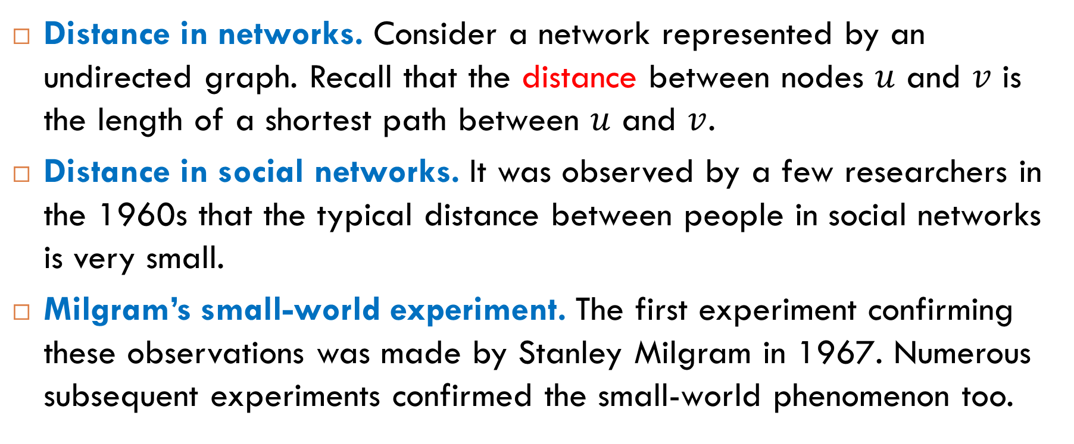
Distance Between People
Distance in networks. Consider a network represented by an undirected graph. Recall that the distance between nodes $u$ and $v$ is the length of a shortest path between $u$ and $v$.
Distance in social networks. It was observed by a few researchers in the 1960s that the typical distance between people in social networks is very small.
Milgram’s small-world experiment. The first experiment confirming these observations was made by Stanley Milgram in 1967. Numerous subsequent experiments confirmed the small-world phenomenon too.

Slide 4
Milgram’s Letter-Passing Experiment (1967)
Forwarding a letter. Participants of the experiment were randomly chosen in Omaha, Nebraska. Each of them was asked to forward a letter to a “target” person. The participants could only advance the letter by forwarding it to an acquaintance that they knew on a first-name basis.
Information about the target person. The only information supplied about the target was his name, address, and occupation (a stock broker). The participants were asked to forward the letter to acquaintance who is most likely to know the target person.
Recording. Each step of the way to the target was recorded in the letter.

Slide 5
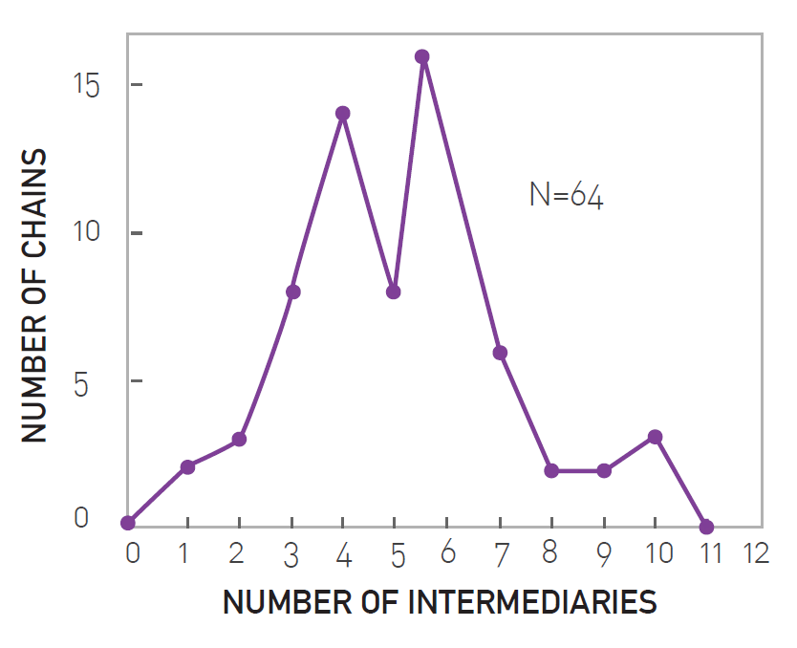
Results
Of the 296 letters sent out, 64 found their ways to the target.
the length distribution of the completed chains

Slide 6
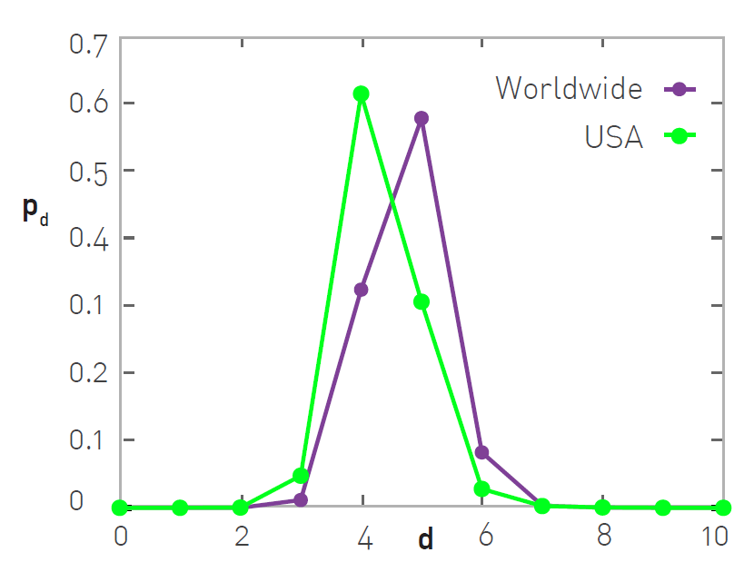
Facebook’s Two-Sided Friendship Graph
the distance distribution for all pairs of Facebook users worldwide and within the USA only

Slide 7
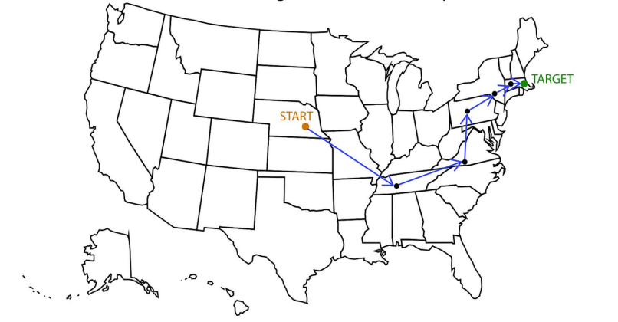
Example of Path

Slide 8
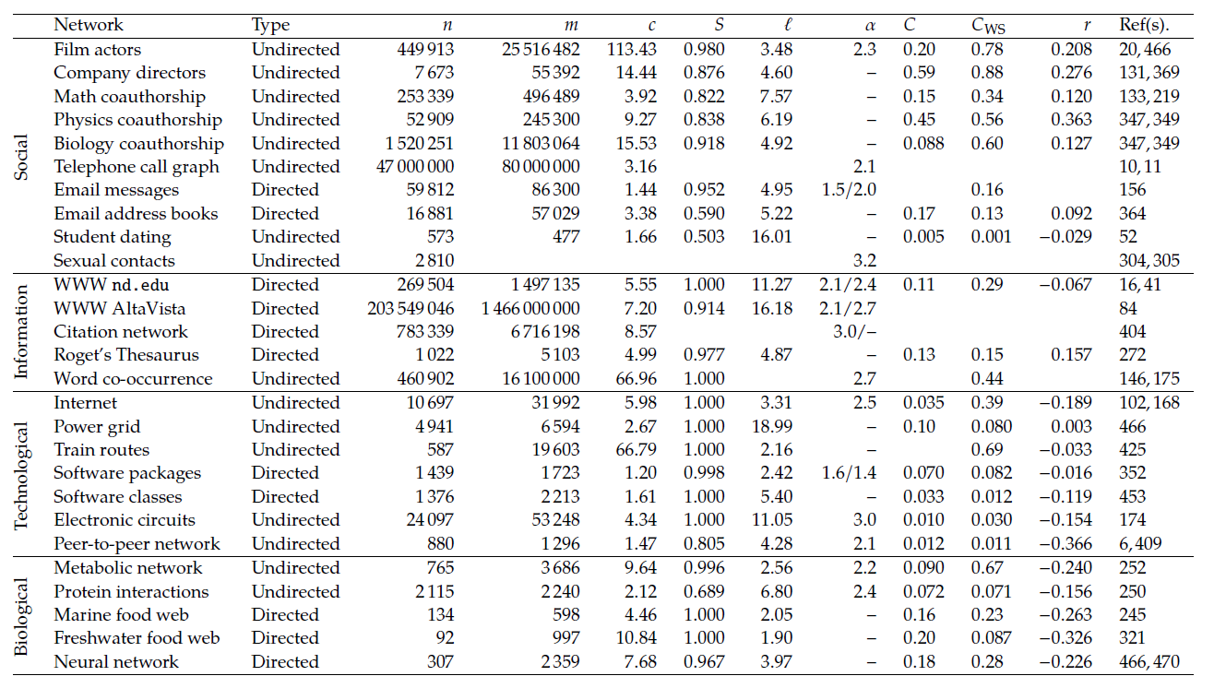
Basic Statistics (Newman’s Book, Table 10.1)
Notes:
$ℓ$ is the mean distance between connected node pairs.

Slide 9
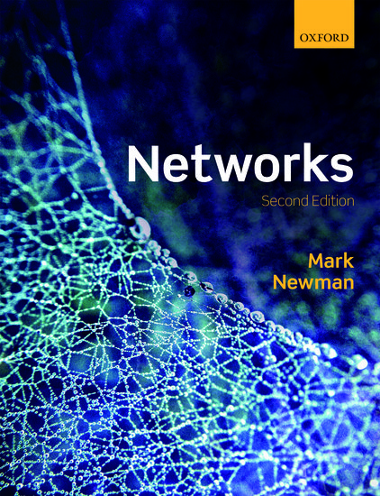
Reading
Sections 4.6, 10.2

Slide 10
Two Results of Milgram’s Experiment

Slide 11
Two Results of Milgram’s Experiment
Short paths
Real-world networks have short paths between their nodes.
Finding short paths
People are able to find short paths.
This result is perhaps more surprising. Why?
Because given a graph, it is easy to find shortest paths (for example, using BFS). However, people in the experiments did not know the entire graph and only knew their personal acquaintances. Yet, they were still able to find a short path to a distant target.

Slide 12
Our Plan on This Topic
We first define a class of networks for which we consider message passing processes. We refer to networks from this class as small-world networks.
Then we define decentralized algorithms for passing messages in small-world networks. A decentralized algorithm that uses a greedy strategy is called myopic search.
Finally, we define what is commonly called Kleinberg’s model of message passing. This model specifies a subclass of small-world networks such that myopic search is efficient on this subclass.

Slide 13
Modeling Small-World Networks

Slide 14
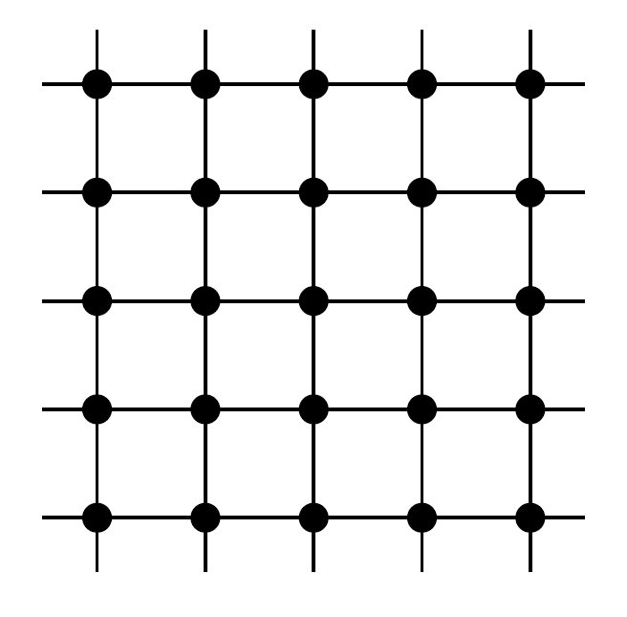
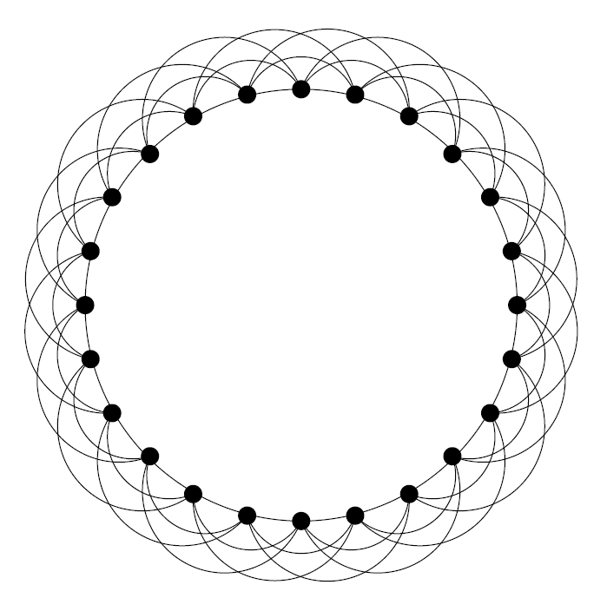
Sparse Graphs with High Transitivity
Real-world networks have two properties:
they are sparse, which means that they have relatively small number of edges.
they have high transitivity, which means that its global and local clustering coefficients are high.
Examples

Slide 15
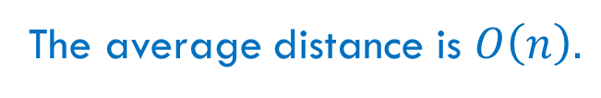
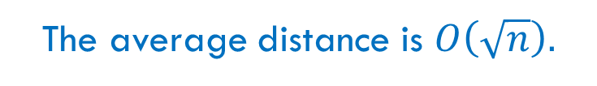
Small World?
Do these graphs have the small-world property?
For both graphs, the answer is “no”.
The average distance is $O\left(\sqrt{n}\right).$
The average distance is $O\left(n\right).$

Slide 16
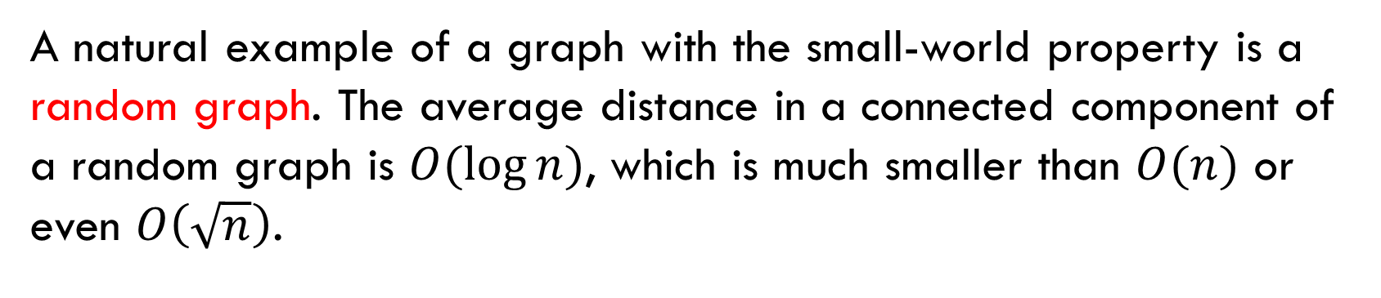
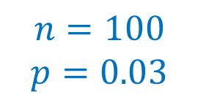
Graphs with Small Average Distance
A natural example of a graph with the small-world property is a random graph. The average distance in a connected component of a random graph is $O(\log{n)}$, which is much smaller than $O(n)$ or even $O\left(\sqrt{n}\right)$.
$$n=100$$
$$p=0.03$$

Slide 17
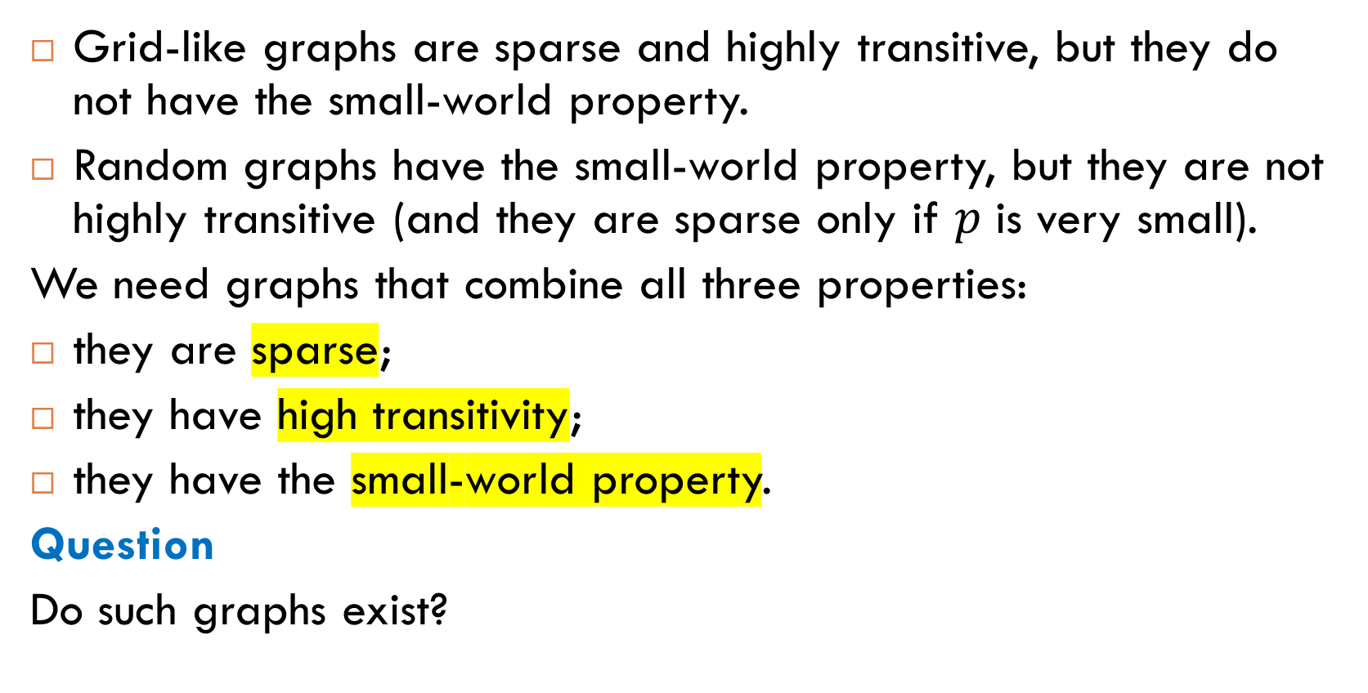
Combining All Three Properties
Grid-like graphs are sparse and highly transitive, but they do not have the small-world property.
Random graphs have the small-world property, but they are not highly transitive (and they are sparse only if $p$ is very small).
We need graphs that combine all three properties:
they are sparse;
they have high transitivity;
they have the small-world property.
Question
Do such graphs exist?

Slide 18
Hybrid Model: Small-World Networks
A graph is called a small-world network if it has all three properties of real-world networks:
it is sparse;
it has high transitivity;
it has the small-world property.
Building
A small-world network can be built in two steps:
Take a sparse graph with high transitivity.
Add a small number of edges to it.

Slide 19
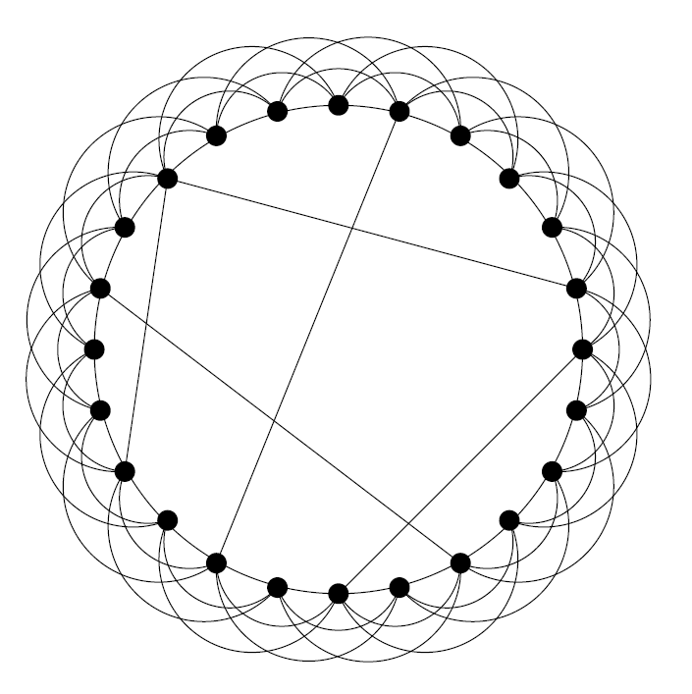
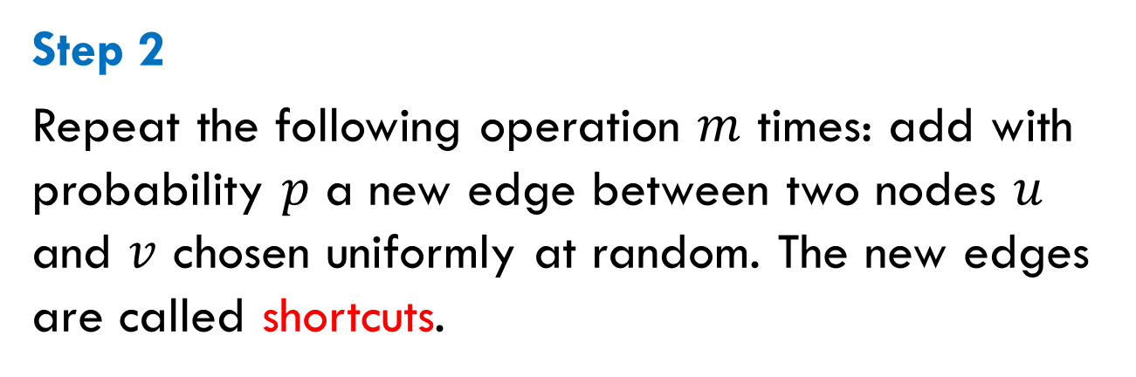
Two Steps of Construction
Step 1
Take a sparse graph with high clustering coefficient, for example a ring-like graph. The edges of this graph are called local edges.
Step 2
Repeat the following operation $m$ times: add with probability $p$ a new edge between two nodes $u$ and $v$ chosen uniformly at random. The new edges are called shortcuts.
Notes:
Later we consider a slightly different method of addition in which 𝑝 depends on the distance between 𝑢 and 𝑣.

Slide 20
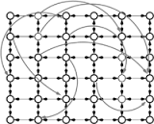
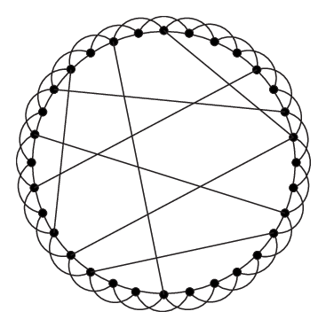
Variations of Small-World Networks
Small-world networks can be directed or undirected:
local edges
shortcuts

Slide 21
Decentralized Algorithms

Slide 22
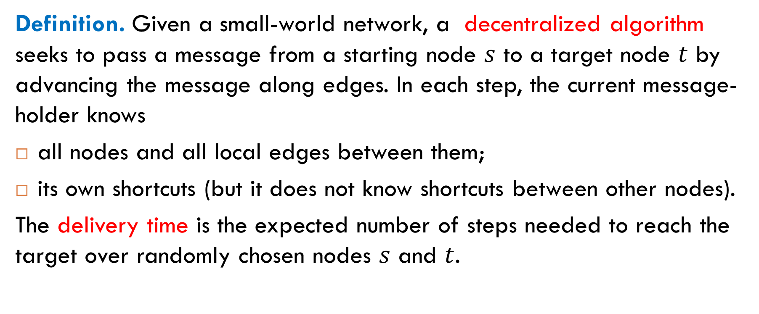
Decentralized Search
Definition. Given a small-world network, a decentralized algorithm seeks to pass a message from a starting node $s$ to a target node $t$ by advancing the message along edges. In each step, the current message-holder knows
all nodes and all local edges between them;
its own shortcuts (but it does not know shortcuts between other nodes).
The delivery time is the expected number of steps needed to reach the target over randomly chosen nodes $s$ and $t$.

Slide 23
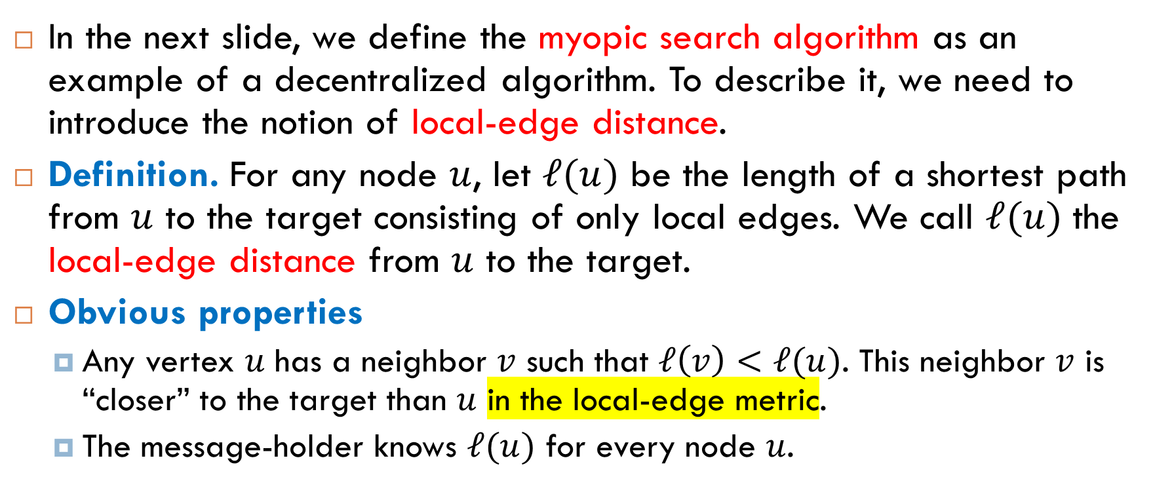
Local-Edge Distance
In the next slide, we define the myopic search algorithm as an example of a decentralized algorithm. To describe it, we need to introduce the notion of local-edge distance.
Definition. For any node $u$, let $ℓ(u)$ be the length of a shortest path from $u$ to the target consisting of only local edges. We call $ℓ(u)$ the local-edge distance from $u$ to the target.
Obvious properties
Any vertex $u$ has a neighbor $v$ such that $ℓ\left(v\right)<ℓ(u)$. This neighbor $v$ is “closer” to the target than $u$ in the local-edge metric.
The message-holder knows $ℓ(u)$ for every node $u$.

Slide 24
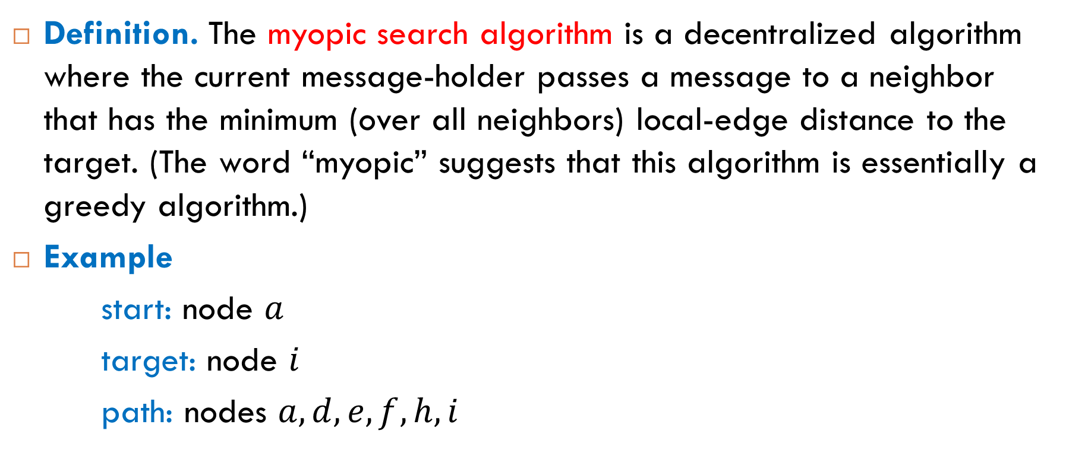
Myopic Search Algorithm
Definition. The myopic search algorithm is a decentralized algorithm where the current message-holder passes a message to a neighbor that has the minimum (over all neighbors) local-edge distance to the target. (The word “myopic” suggests that this algorithm is essentially a greedy algorithm.)
Example
start: node $a$
target: node $i$
path: nodes $a, d, e, f, h, i$

Slide 25
Analysis of Myopic Search

Slide 26
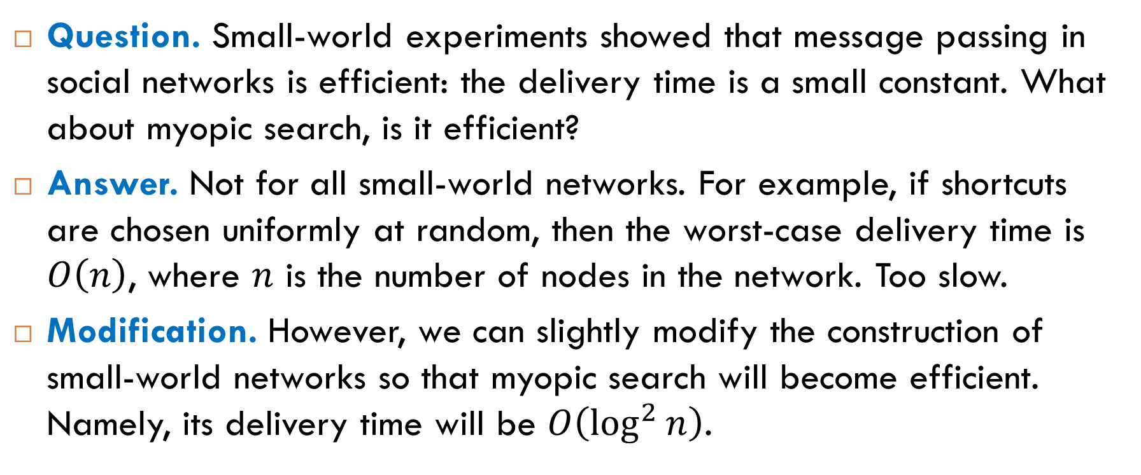
Is Myopic Search Efficient?
Question. Small-world experiments showed that message passing in social networks is efficient: the delivery time is a small constant. What about myopic search, is it efficient?
Answer. Not for all small-world networks. For example, if shortcuts are chosen uniformly at random, then the worst-case delivery time is $O\left(n\right)$, where $n$ is the number of nodes in the network. Too slow.
Modification. However, we can slightly modify the construction of small-world networks so that myopic search will become efficient. Namely, its delivery time will be $O\left(\log^{2}{n}\right)$.

Slide 27
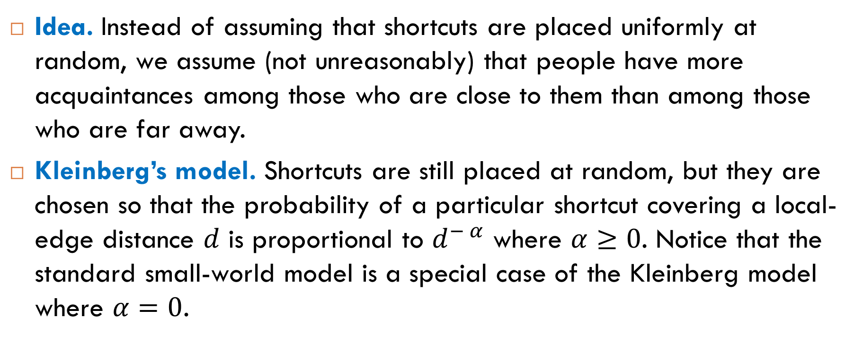
Modification: Kleinberg’s Model
Idea. Instead of assuming that shortcuts are placed uniformly at random, we assume (not unreasonably) that people have more acquaintances among those who are close to them than among those who are far away.
Kleinberg’s model. Shortcuts are still placed at random, but they are chosen so that the probability of a particular shortcut covering a local-edge distance $d$ is proportional to $d^{− α}$ where $α≥0$. Notice that the standard small-world model is a special case of the Kleinberg model where $α=0$.
Notes:
The Easley & Kleinberg book, section 20.7, gives more details of how to place shortcuts in this model.

Slide 28

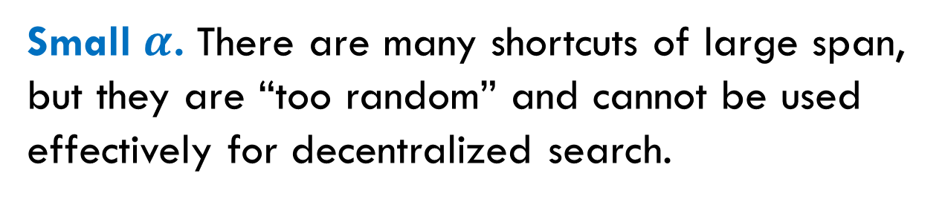

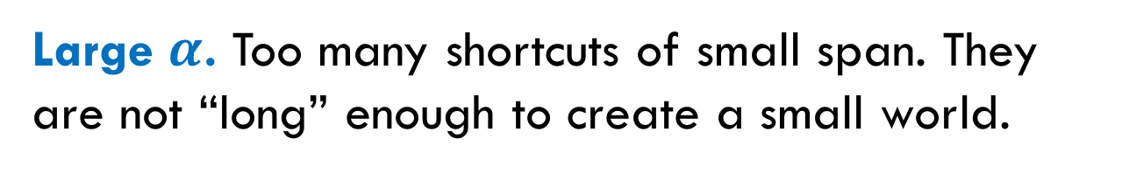
Should $α$ Be Large or Small?
Question. Is there a good trade-off for $α$ at which myopic search is efficient?
Large $α$. Too many shortcuts of small span. They are not “long” enough to create a small world.
Small $α$. There are many shortcuts of large span, but they are “too random” and cannot be used effectively for decentralized search.

Slide 29

Trade-Off for Grid-Based Networks
Jon Kleinberg gave a positive answer to this question for grid-based networks that are obtained from $k$-dimensional grids by adding random shortcuts. Here are examples of such networks:
network based on one-dimensional ring
directed network based on two-dimensional grid

Slide 30
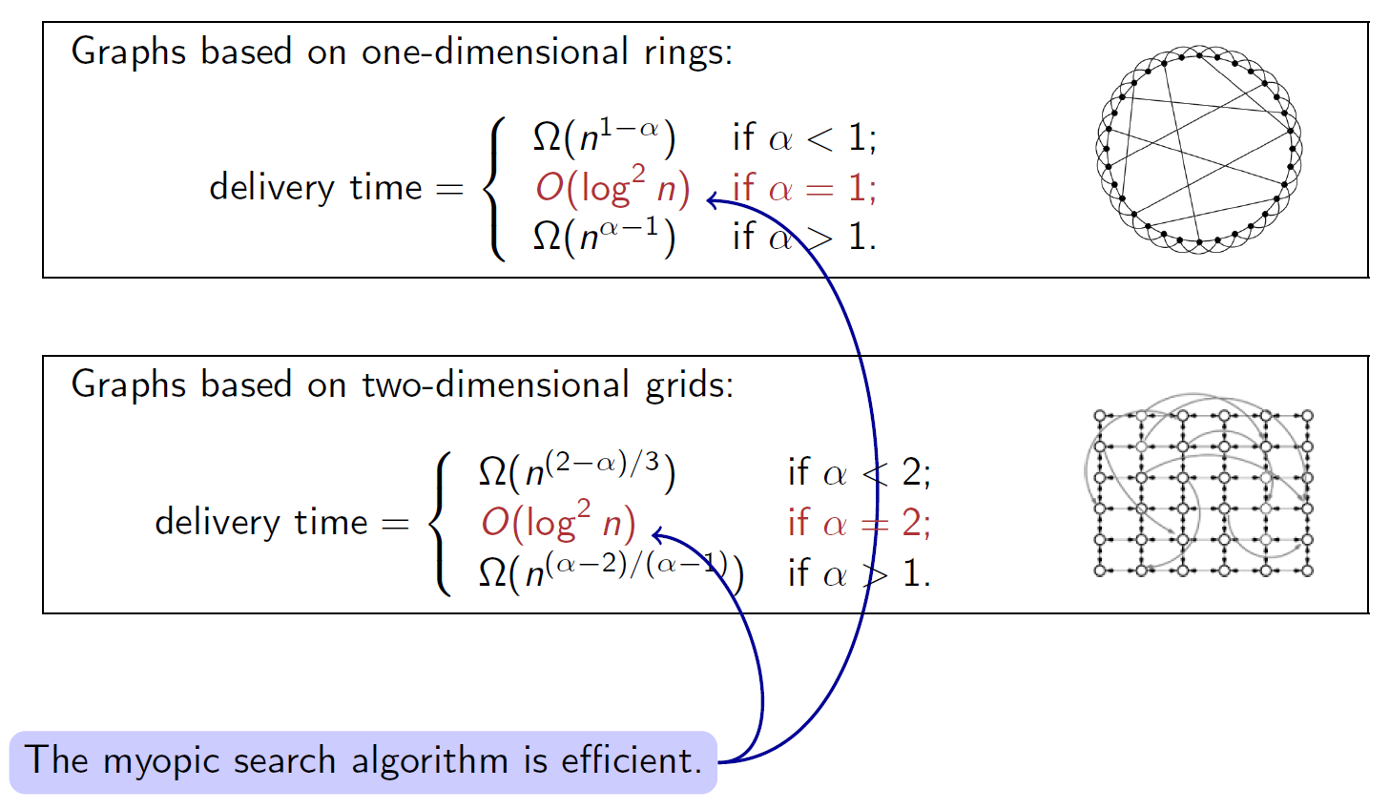
Delivery Time for Grid-Based Networks

Slide 31
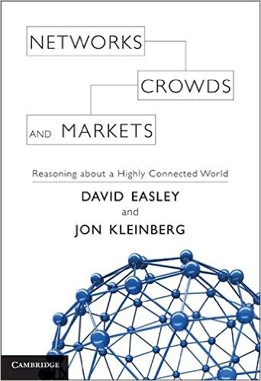
Reading
Section 18.3
Sections 20.3, 20.7A

